Slide 1

Welcome to our phonics information sharing session

Slide 2
Phonics and Early Reading
Part 1 – information about how we teach phonics
Part 2 – information about how we teach reading
Part 3 – supporting at home

Slide 3
What is Phonics?
Phonics is a way of teaching children how to read and write.
It helps children hear, identify and use different sounds that distinguish one word from another in the English language

Slide 4
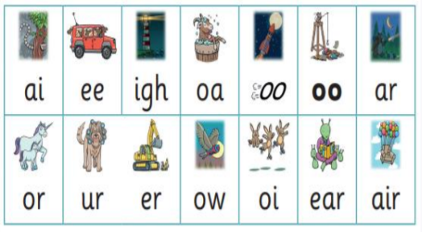
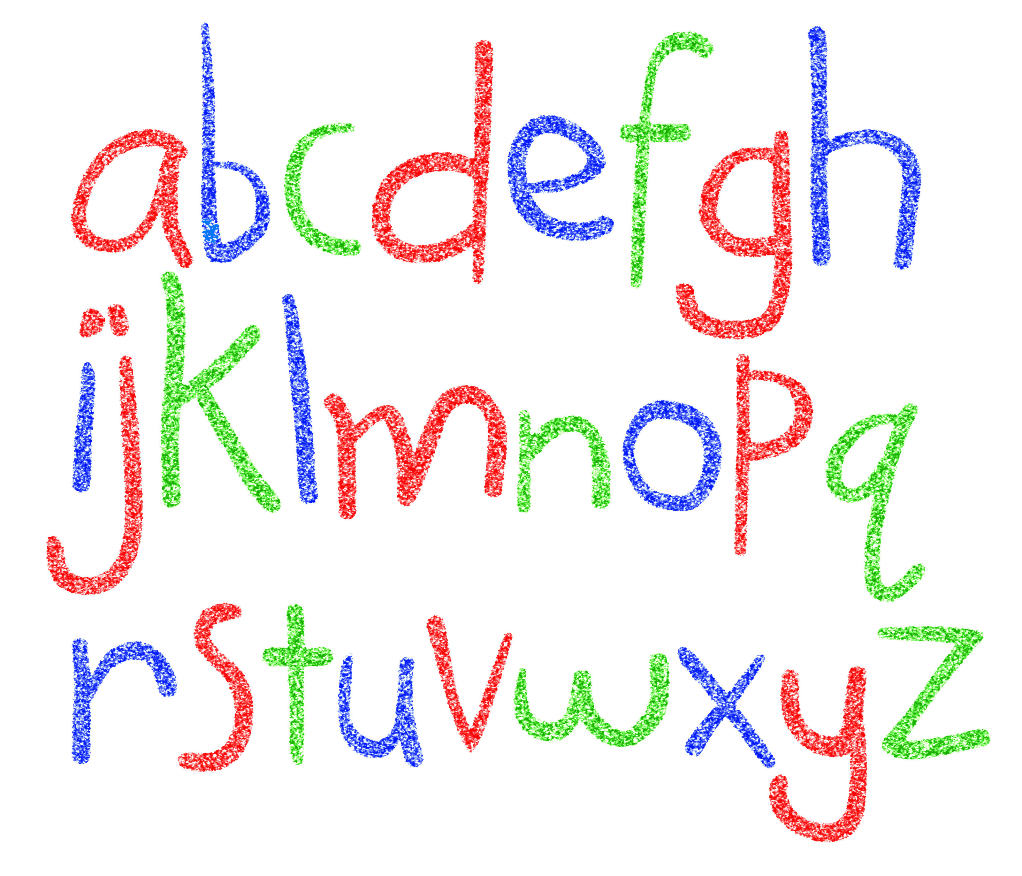

Did you know?
The English language has:-
26 letters
44 sounds
Over 100 different ways to spell those sounds

Slide 5

New DFE Guidance for Early Reading and Phonics
The journey to independent reading and writing begins with Phonics
littlewandlelettersandsounds.org.uk
Why Little Wandle?
Excellent training for all staff to ensure consistency.
Every aspect of phonics and reading included in a detailed, thorough and systematic approach.
Engaging resources without distracting from the learning.
Comprehensive system for identifying and supporting children requiring extra help
Useful support for parents.
Notes:
Government changes mean a change (for the better) in how we teach phonics and reading at school - make sure there is consistency throughout
Early reading is the stage where children are learning to become fluent readers through the use of phonics

Slide 6
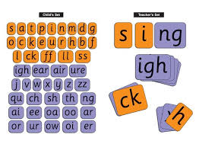
How we teach phonics
Daily short sessions
Specific order of teaching
Synthetic phonics
Repeated practice
m-u-s-t
Correct pronunciation
- is vital - Videos on LW
https://www.littlewandlelettersandsounds.org.uk/resources/for-parents/

Slide 7
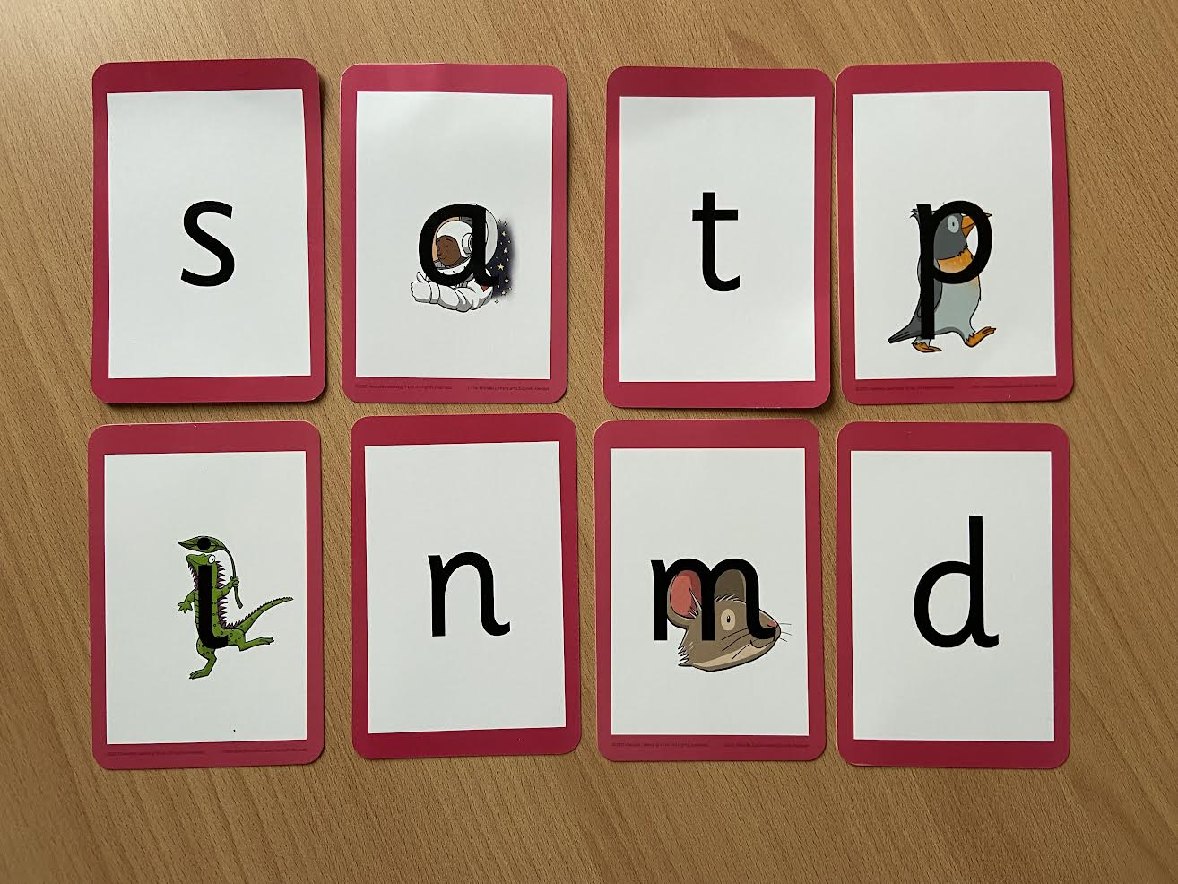
Notes:
Phonemes taught in order start to read words asap
LW has a picture pneumonic to help children remember the phoneme/grapheme

Slide 8
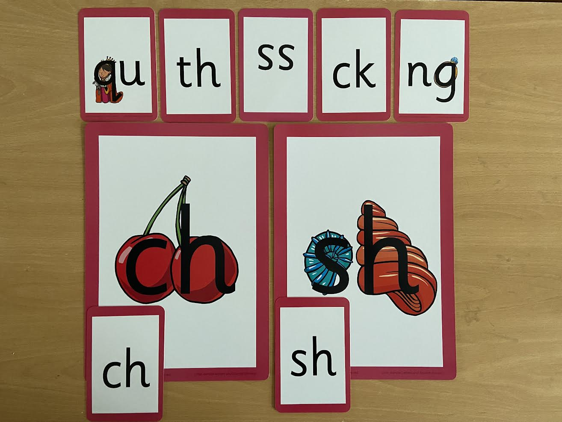
Notes:
Early digraphs mostly consonant digraphs – 2 letters 1 sound

Slide 9
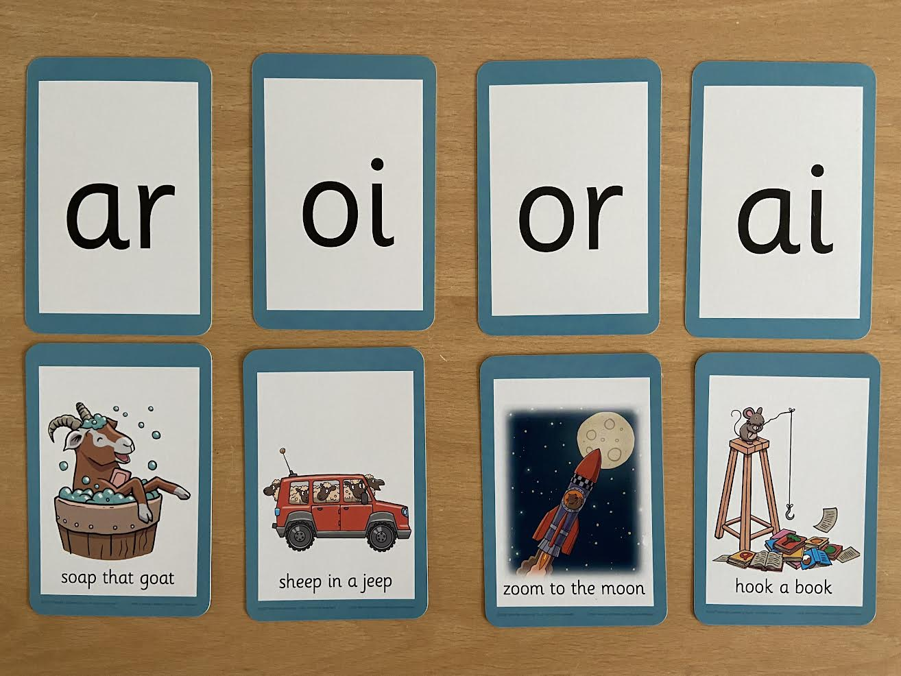
Notes:
Vowel digraphs taught with a short caption to help children remember
Also trigraphs igh, air

Slide 10
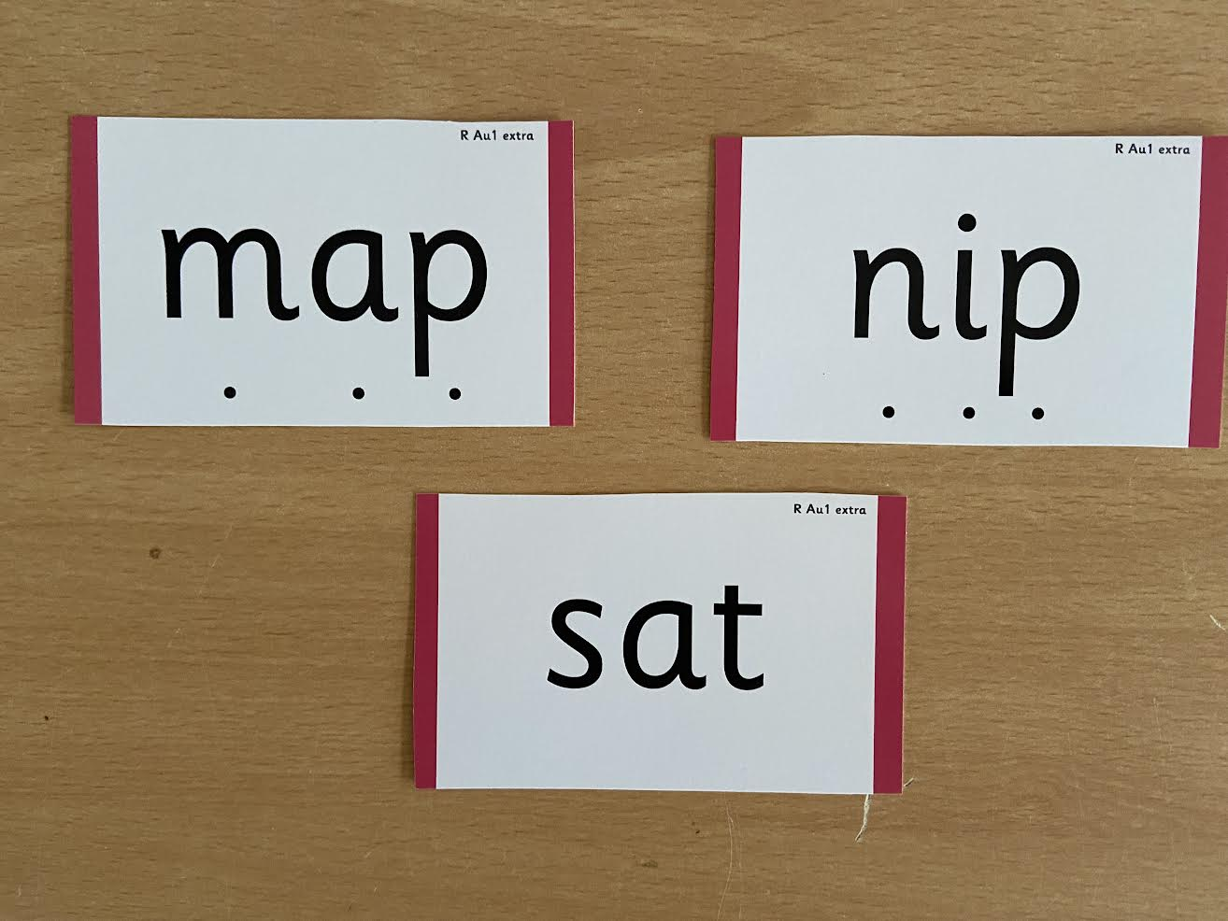
Notes:
During phonics lessons we use Sound buttons so we can sound talk and blend to read

Slide 11
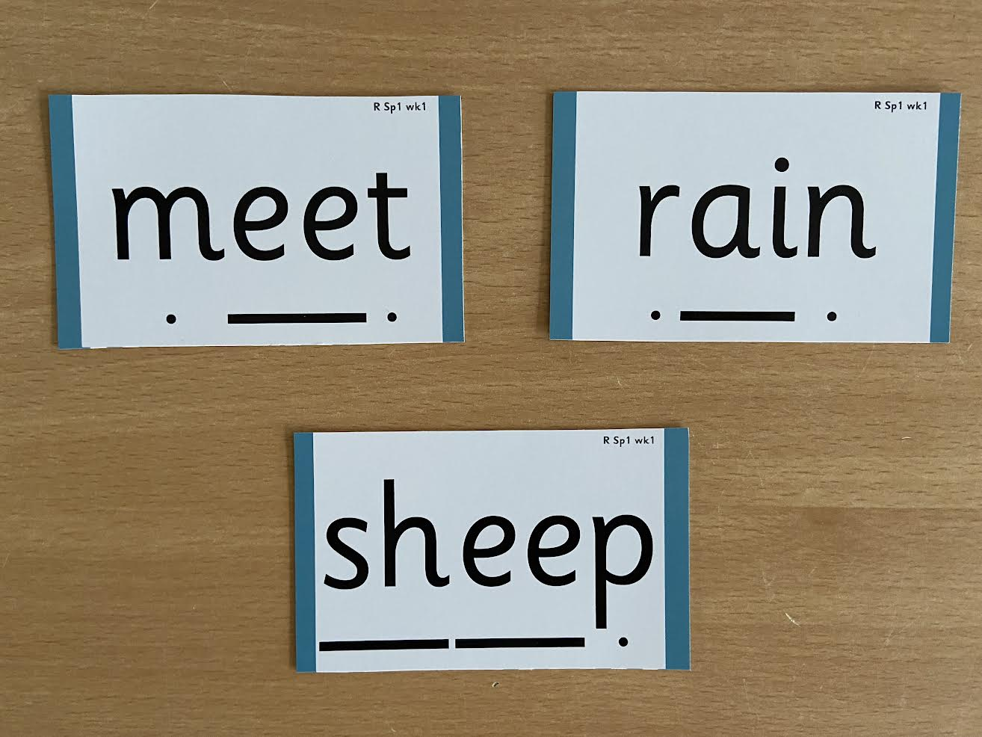
Notes:
Digraphs have a line to sound talk and blend

Slide 12
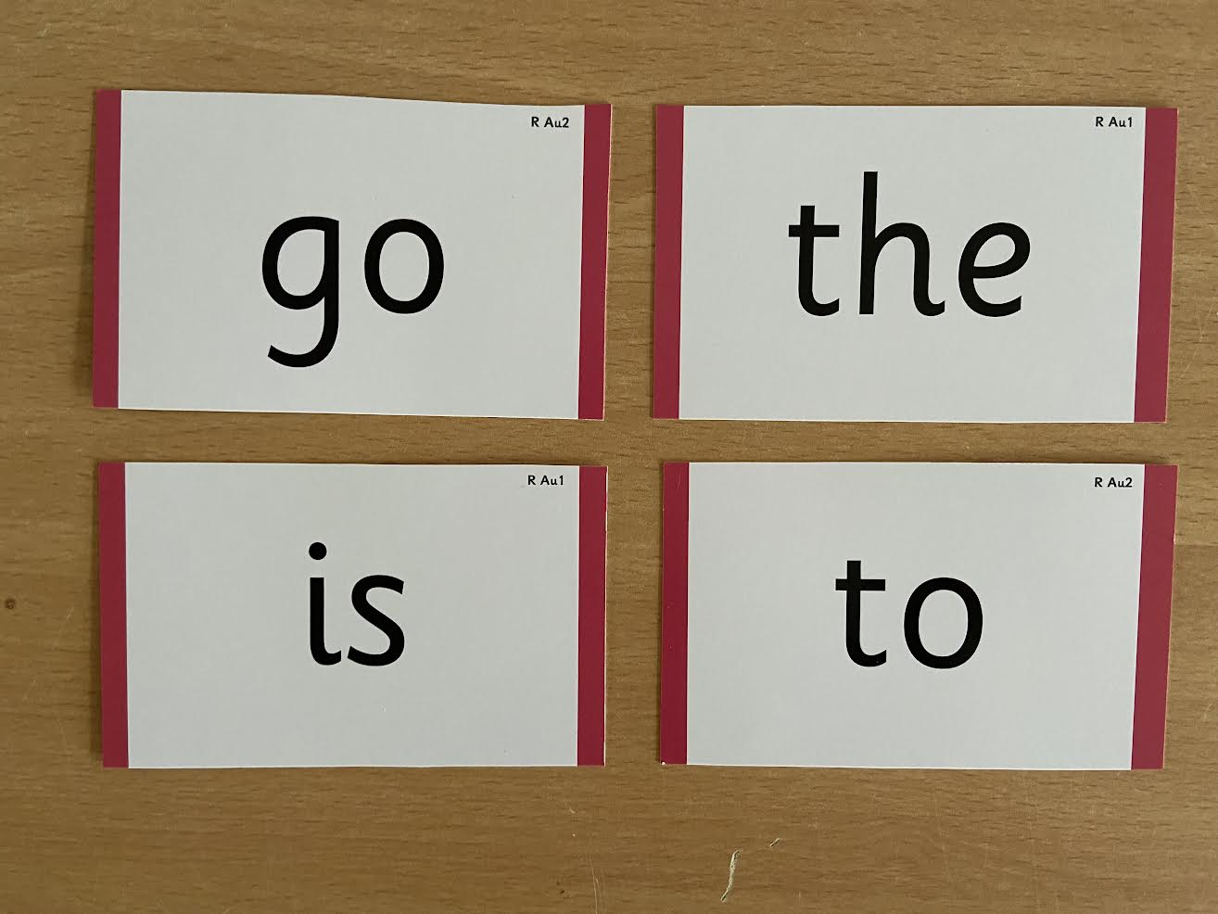
Notes:
Words that do not follow the rules and cannot be decoded – tricky words/ exception words
Chn are taught what part of the word is tricky

Slide 13


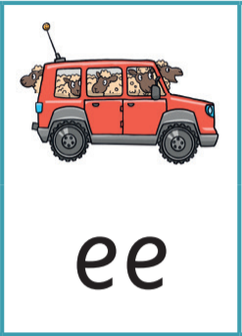
Jargon
You may hear your children say….
-phonics (also known as ‘synthetic phonics’) – The teaching of reading by developing awareness of the sounds in words and the corresponding letters used to represent those sounds.
phoneme - Any one of the 44 sounds which make up words in the English language.
-grapheme – How a phoneme is written down. There can be more than one way to spell a phoneme. E.g-the phoneme ‘ay’ is spelt differently in each of the words ‘way’, ‘make’, ‘fail’, ‘great’, ‘sleigh’ and ‘lady’.
-blending – Putting together the sounds in a word in order to read it, e.g.
‘f – r – o – g, frog’
-segmenting – Breaking a word into sounds in order to spell
them, e.g. ‘frog, f – r – o – g’’
-Digraph- 2 letters making one sound
-Trigraph- 3 letters making one sound

Slide 14

Reading
We want children to
love reading
Learning to read should be
a positive experience
Reading should be
enjoyable
We want children to read
for pleasure and be life
long readers
Reading underpins children’s access to the curriculum
and clearly impacts on their achievement
Notes:
We all know how important learning to read is and the impact it has on a childs success - it has to be a positive experience
Whats the reality? Reluctant to read because they find it hard
Frustration stress tears – that’s just the parents
Important to look at the big long term picture

Slide 15
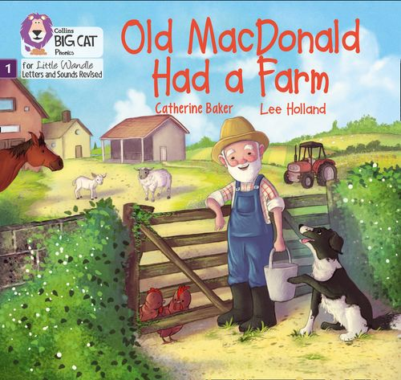
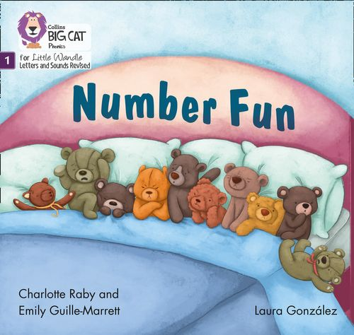

Once children have a secure knowledge of a number of GPC’s (Grapheme Phoneme Correspondences) and are confidently blending, they will be ready for reading books.
Prior to this they may have wordless books which develop great language skills and teach children the layout of books and how to handle books

Slide 16

How we teach reading
Reading practice sessions are :
Books are :
Timetabled 3 times a week
matched to children’s
secure phonic knowledge
and word reading
Taught by trained teacher or
teaching assistant
read three times
Taught in small groups
Same matching book sent home
Notes:
Quite a big difference to how reading was previously taught

Slide 17
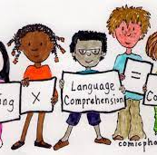
Reading Practice Books carefully matched so children can read fluently and independently
3 Reads – each one begins with some quick sounds and words practice
Decoding
Prosody (intonation, expression)
Comprehension
When children take their book home to read they should be 95% fluent.
Please do not worry that a book is too easy – your child needs to develop fluency and confidence in reading. Re-reading a book they have had before helps develop fluency – this is the goal.
Celebrate their success!!!

Slide 18
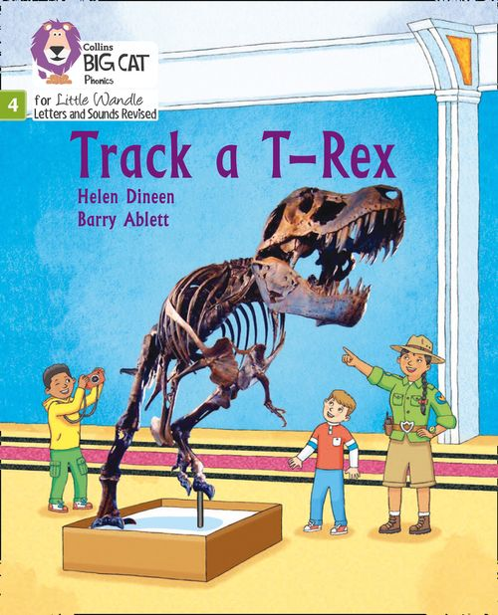
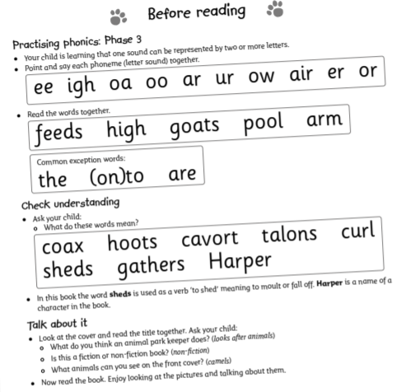
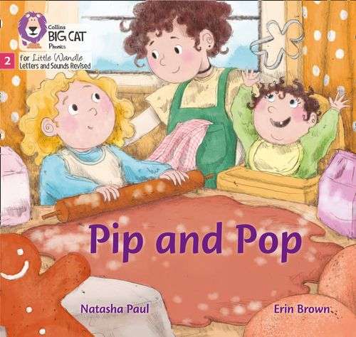

How do we decide which books children read?
Children are assessed, then LW matches which books Should be allocated for their secure phonic knowledge.
Once the children have read the text 3x at school we will then allocate that same book for them to read at home.
Share the front cover page before reading – this cover sounds and words contained in the book.
Celebrate, praise, talk about the book with you child.

Slide 19




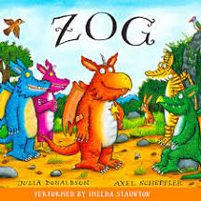
Supporting at home.
Reading for pleasure books
Children can also bring home a ‘reading for pleasure book’ from our class library each week.
To become lifelong readers, it is essential that they read for pleasure
Children may not be able to read this book independently, but these books offer a wealth of opportunities for talking about the pictures and enjoying the story or information text.
Enjoy the book together and foster a love of reading

Slide 20
