Slide 1
Starter
Play a couple of games of numbots.

Slide 2
Friday 19th March
100s I can apply mathematical knowledge to solve problems.

Slide 3
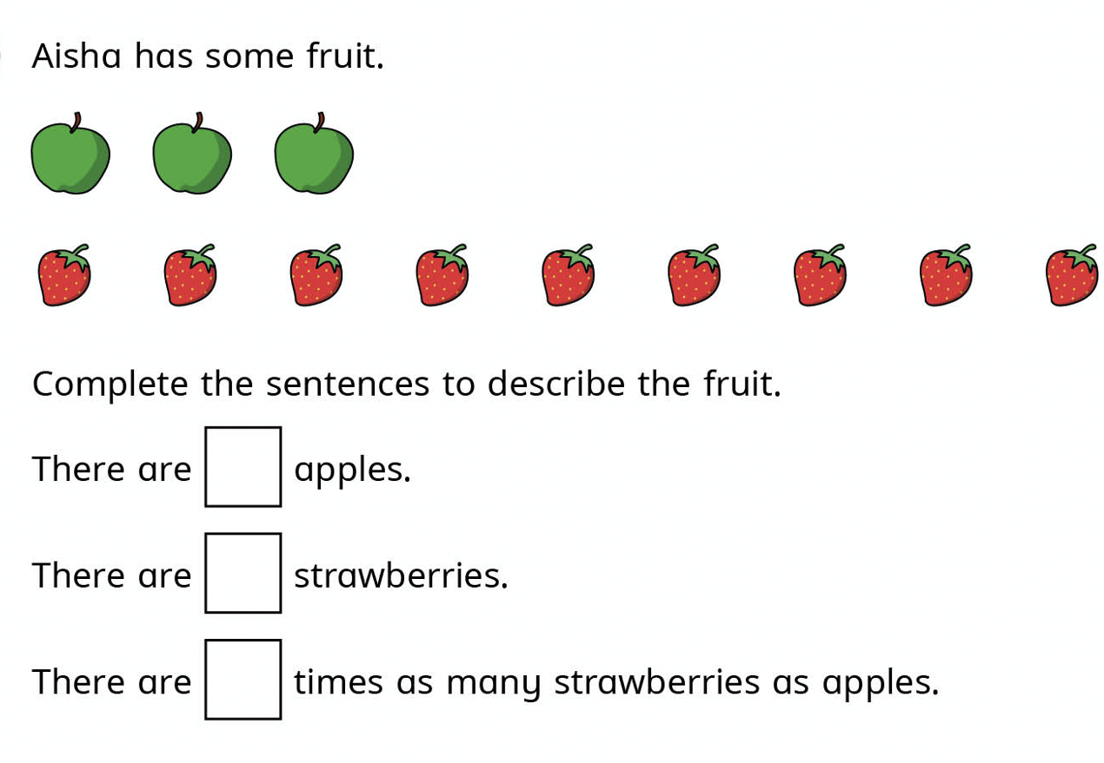
100s
Notes:
.

Slide 4
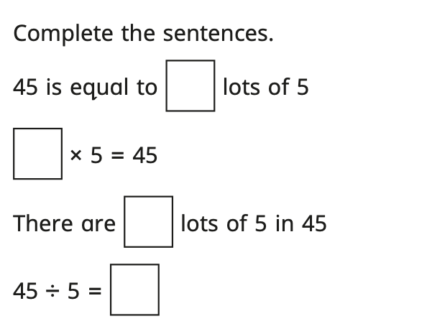
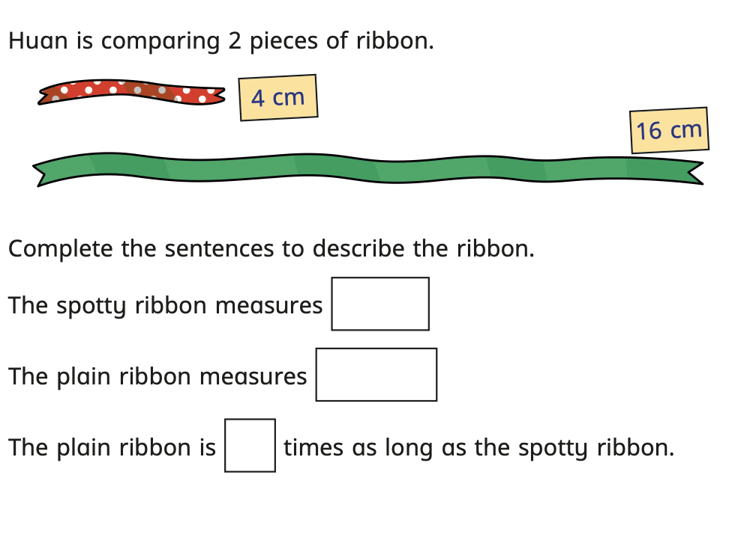
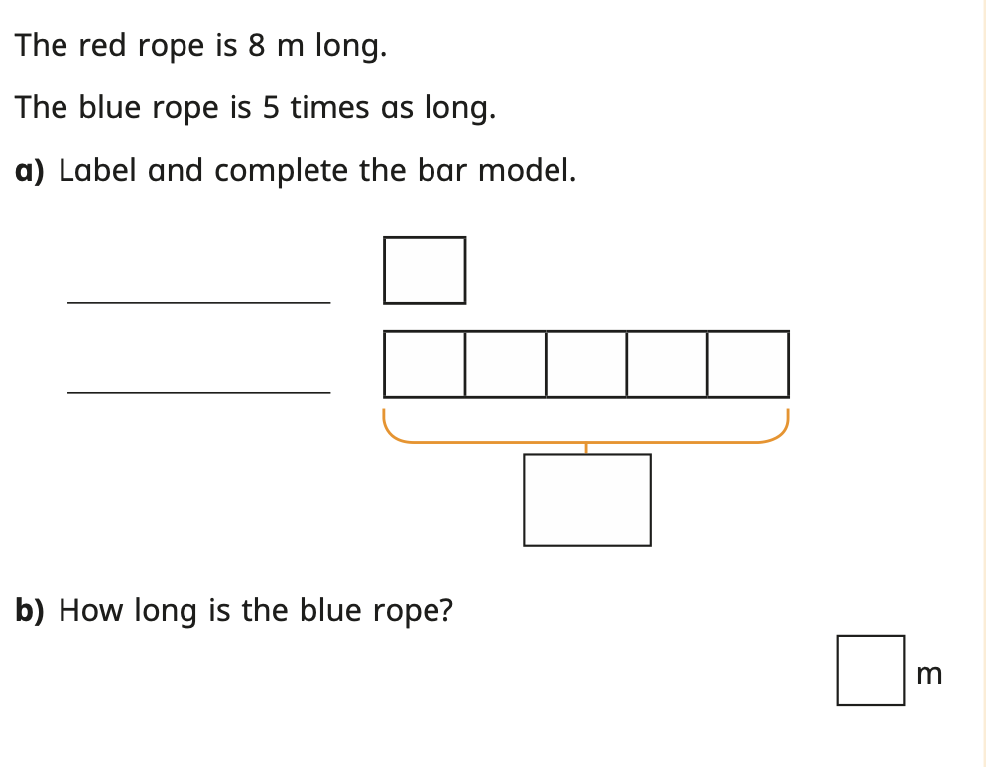
100s Bronze Challenge | Silver Challenge | Gold Challenge
Notes:
]

