Slide 1
Maths
10.03.2023

Slide 2
$$>$$
1) 3.124 2.124
2) 5.348 5.389
3) 965 987
4) 1000 999
<
<
>

Slide 3
12 $×$ 7 $=$ 84
12 $+$ 72 $=$ 84
1)
2)
3)
4)
55 $÷$ 11 $=$ 5
55 $−$ 50 $=$ 5
60 $÷$ 6 $=$ 10
120 $÷$ 6 $=$ 20
9 $×$ 8 $=$ 72
8 $×$ 9 $=$ 72

Slide 4
12 $×$ 7 $=$ 84
12 $+$ 72 $=$ 84
1)
2)
3)
4)
55 $÷$ 11 $=$ 5
55 $−$ 50 $=$ 5
60 $÷$ 6 $=$ 10
120 $÷$ 6 $=$ 20
9 $×$ 8 $=$ 72
8 $×$ 9 $=$ 72

Slide 5
Video link
Y5 Spring Block 3 TS9 Order and compare any decimals with up to 3 decimal places on Vimeo
Year 5 –Decimals and Percentages
LT: To read, write, order and compare numbers with up to 3 decimal places. To solve problems involving numbers up to 3 decimal places.
Notes:
Molly Lesson – Year 5

Slide 6
Which number is greater?
O | Tth | Hth | Thth
O | Tth | Hth | Thth
0.441
$$<$$
0.463
First, I need to look at the ______ column.
tenths
If the digits in the tenths column are the same, I need to look at the __________ column.
hundredths
Have a think

Slide 7
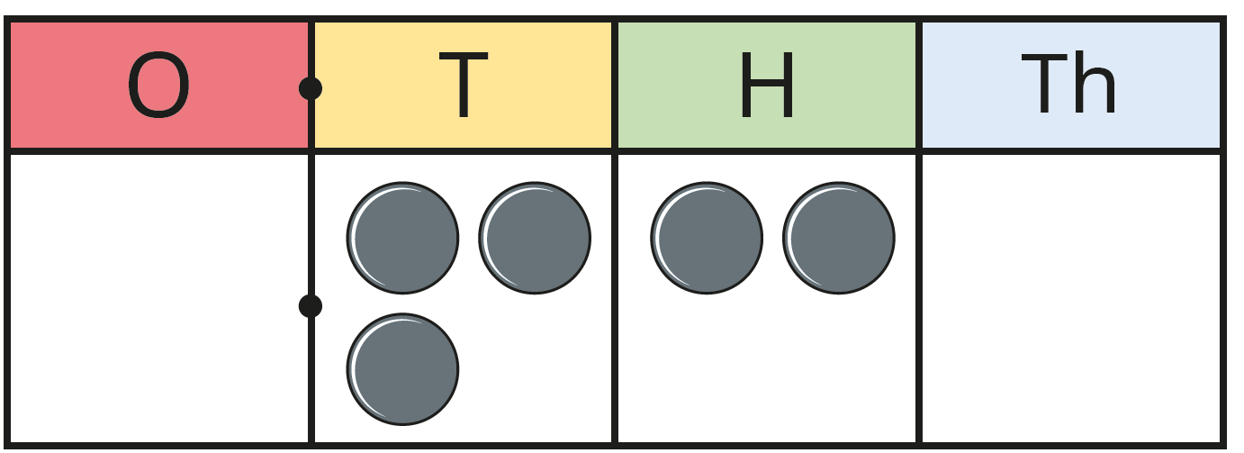
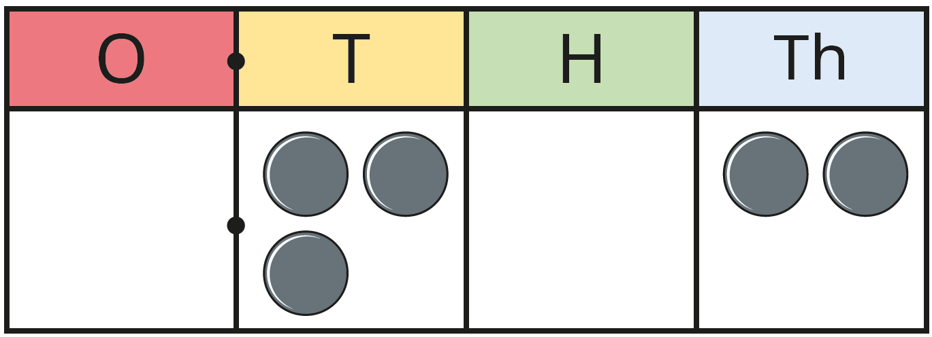
The place value charts show the numbers 0.32 and 0.302
What is the same?
What is different?
Which number is greater? How do you know?
0.32 is the greater number. 0.320 $>$ 0.302
Have a think

Slide 8
Which number is greater?
O | Tth | Hth | Thth
O | Tth | Hth | Thth
3.41
$$>$$
3.063
First, I need to look at the ______ column.
ones
If the digits in the ones column are the same, I need to look at the ______column.
tenths
Have a think

Slide 9
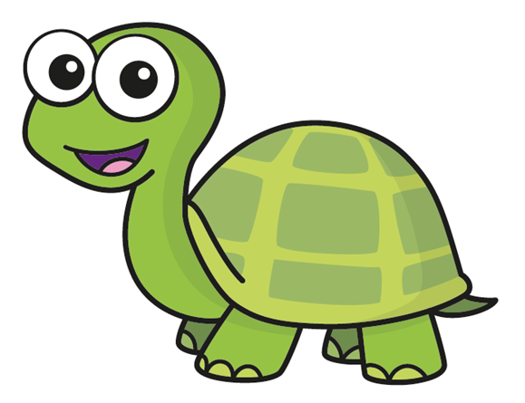
One | Tenths | Hundredths
13 is greater than 2 so the bottom number is greater.
2
Ones | Tenths | Hundredths
0.2 0.13
>
Is Tiny correct?
1
3

Slide 10
Use $<$, $>$ or $=$ to compare the numbers.
>
2.7 2.55
2.70 2.55
>
5.712 5.7
5.712 5.700
Have a think
How do you know which number is greater?

Slide 11
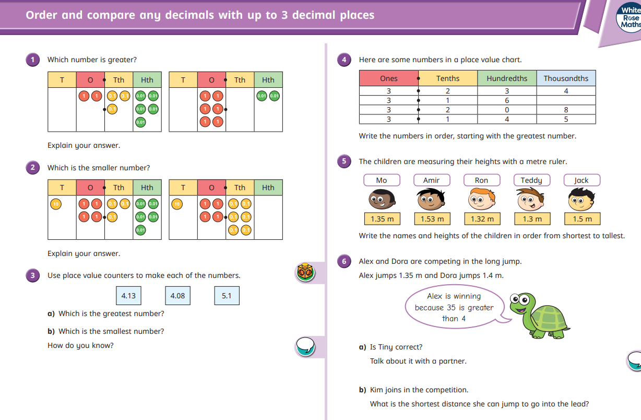
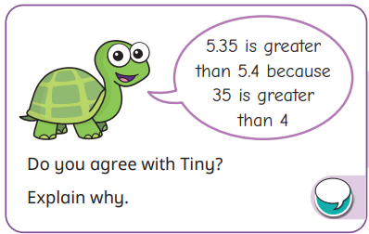
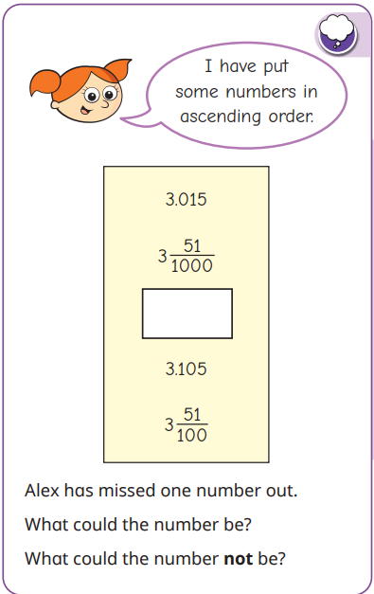
Bronze Challenge | Silver Challenge | Gold Challenge
Notes:
Year 5

Slide 12
Video link
Year 6 Spring Block 2 TS1 1-step function machines on Vimeo
Year 6 – Algebra
LT: To use simple formulae.
To generate and describe linear number sequences.

Slide 13
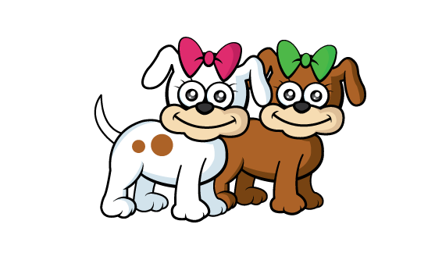
Dora is completing the table.
She’s trying to find a rule to help her find the number of legs 60 dogs would have altogether.
Number of dogs | 1 | 2 | 3 | 4 | 5 | 10 | 60
Number of legs
Have a think

Slide 14
Dora is completing the table.
She’s trying to find a rule to help her find the number of legs 60 dogs would have altogether.
Number of dogs | 1 | 2 | 3 | 4 | 5 | 10 | 60
Number of legs
$×$4
$×$4
$×$4
$×$4
$×$4
$×$4
$×$4
4
8
12
16
20
24
40
240

Slide 15
Input
Output
5
$×$ 6
?
30
5 $×$ 6
27
$+$ 9
?
?
$−$ 3
46
Have a think

Slide 16
Input
Output
5
$×$ 6
30
27
?
$+$ 9
36
?
49
$−$ 3
46
$−$ 3 $=$ 46
46 $+$ 3 $=$

Slide 17
Bronze Challenge | Silver Challenge | Gold Challenge
 |  | SATs Challenge Cards
Notes:
Year 6

Slide 18
Self-Reflection
How did we get on today?

