Slide 1
The Darkest Dark by Chris Hadfield
English

Slide 2
Timeline of events
Chris couldn’t sleep. He imagined aliens in his room.
Parents searched the room for aliens.
Chris awoke again and kept ringing the bell.
Chris woke his parents up.
Chris was put back to bed and given a bell.
His father said they wouldn’t be able to take part in the special day if he didn’t sleep.
How did Chris and his parents feel at each event?
Notes:
Create a timeline of events.
Pupils write down the timeline in their own notes.
Ask pupils to add how the parents felt and how Chris felt at each event.

Slide 3
Your task
Write a recount of ‘Chris’s strange night’ using the timeline as your planning.
Remember:
Use a variety of verb forms (progressive, perfect, modals).
Begin each new paragraph when the event changes and add adverbial phrases to introduce each paragraph (new time, new place).
Use relative clauses and subordinate clauses to vary your sentence structure.
Notes:
If possible using your online platform, ask pupils to read and evaluate other pupils’ noun phrases, selecting their favourites to share with the class.

Slide 4
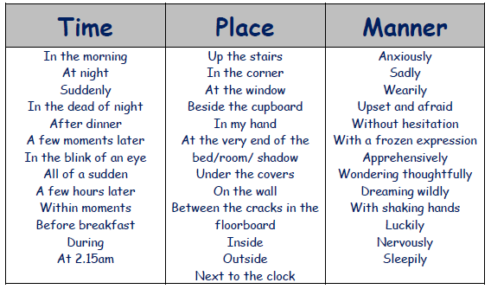
Fronted Adverbials

