Slide 1
https://www.youtube.com/watch?v=NXkJ88ygPY0
10.03.2023
LT: I can recall, say and write about French food and drink.

Slide 2
Listen and repeat.
https://www.youtube.com/watch?v=XLIE6hYGaF0
I like-
I don’t like –
I love –
I hate –
Because it is- -
j'aime
je n'aime pas
J’adore
je déteste
parce que c'est
Why I like ?
Delicious - Délicieux(masculine)
Tasty - savoureux
Why I don’t like?
Too sweet- trop sucré
Chewy –moelleux
Bland - nourriture fade

Slide 3
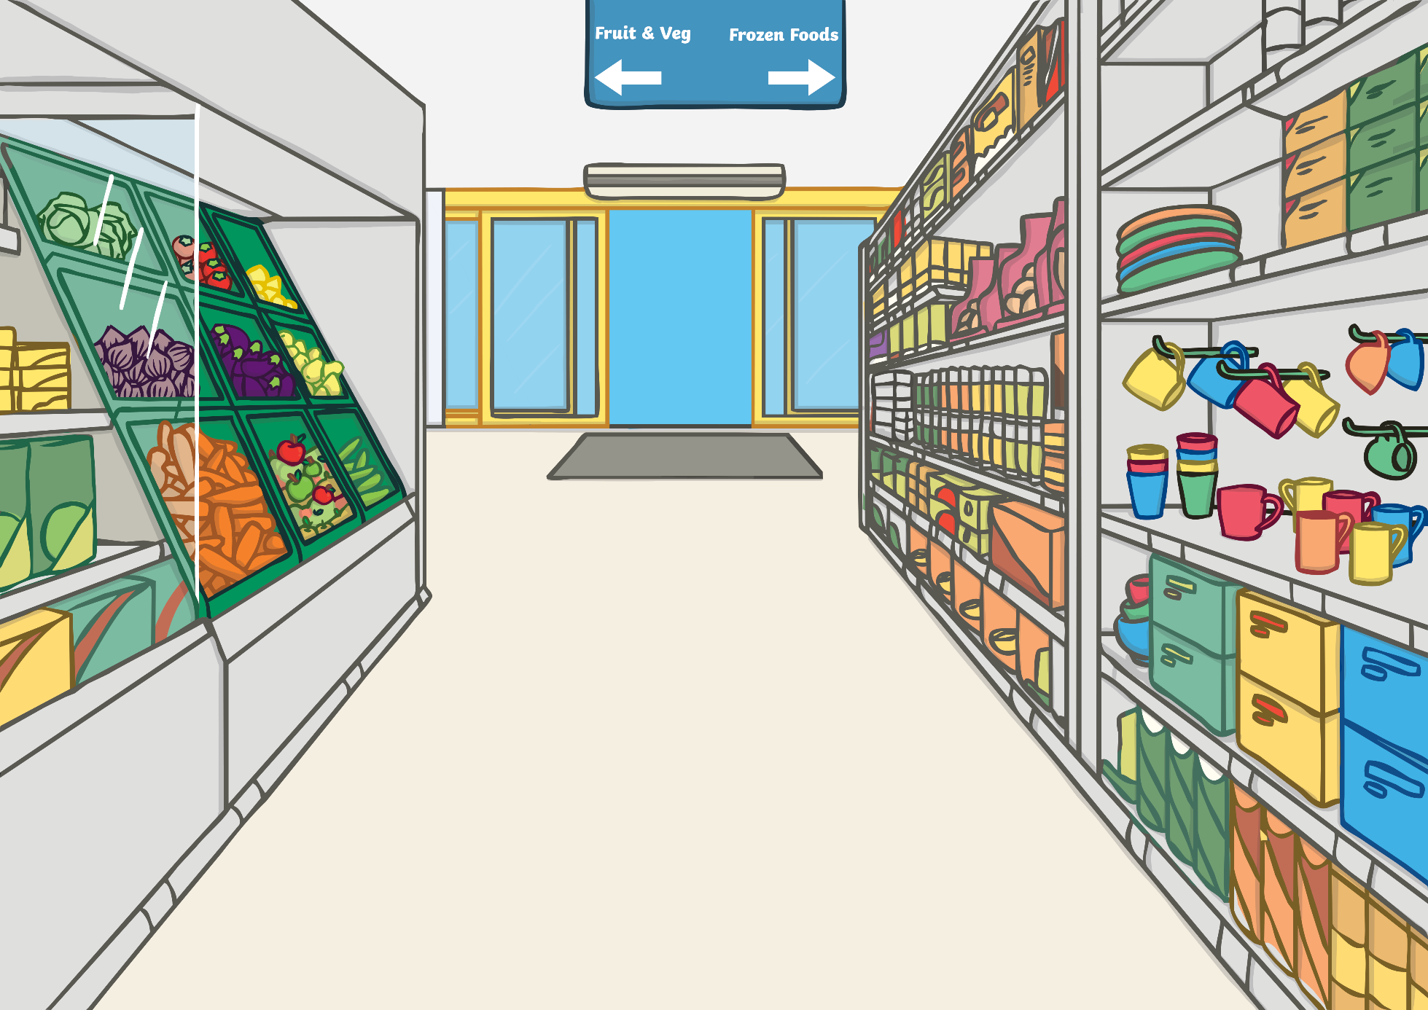
le jus
d’orange

Slide 4
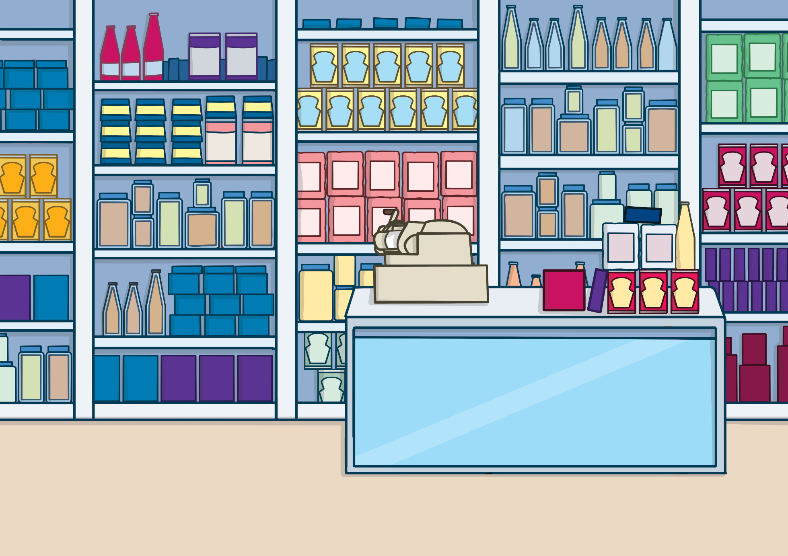
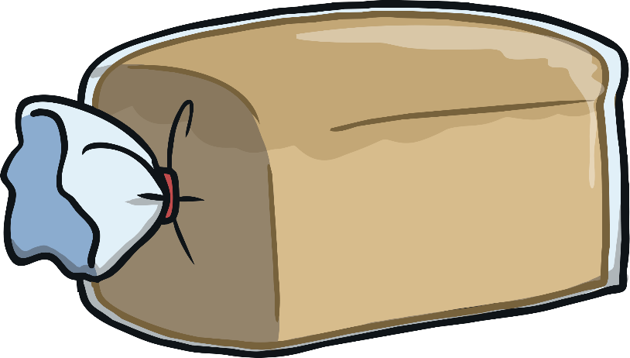
le pain

Slide 5
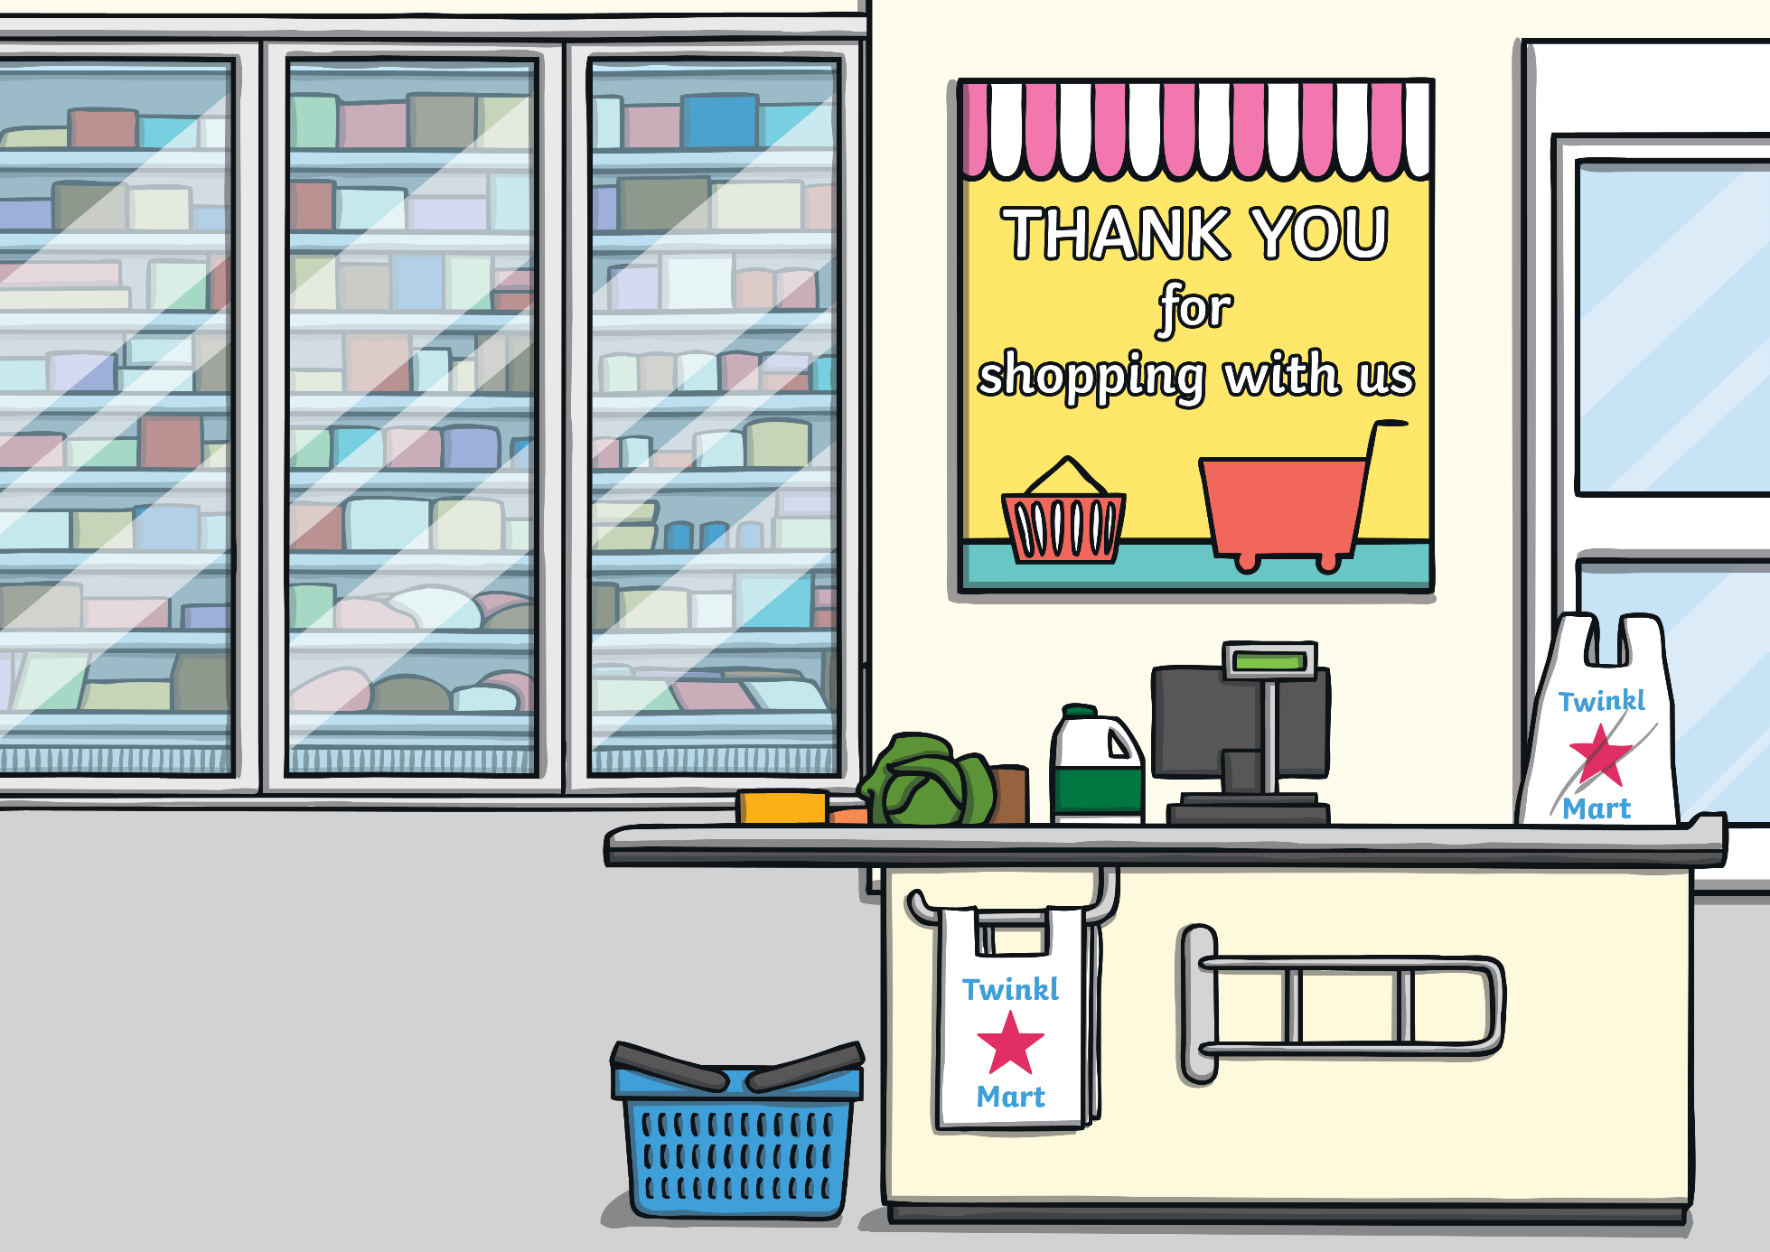
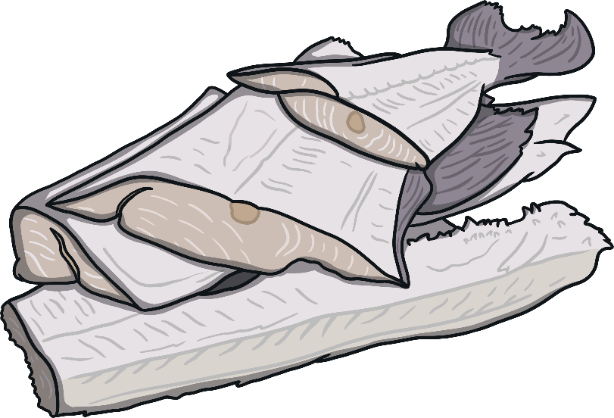
le poisson

Slide 6
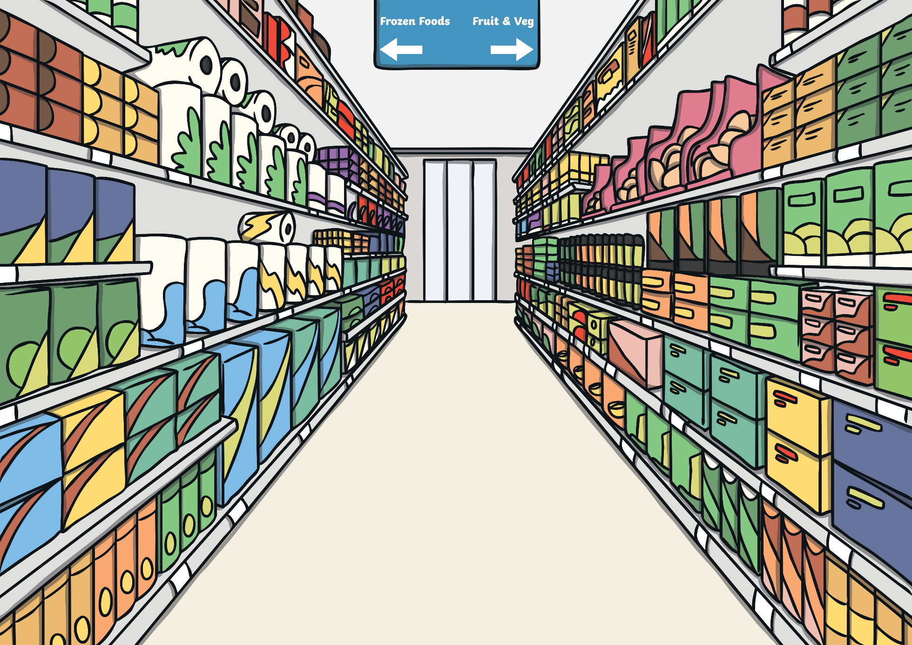
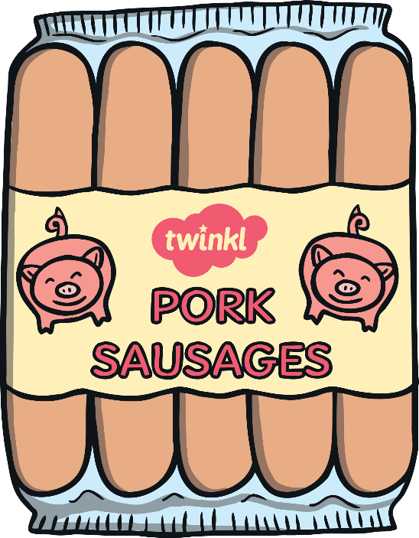
les saucisses

Slide 7
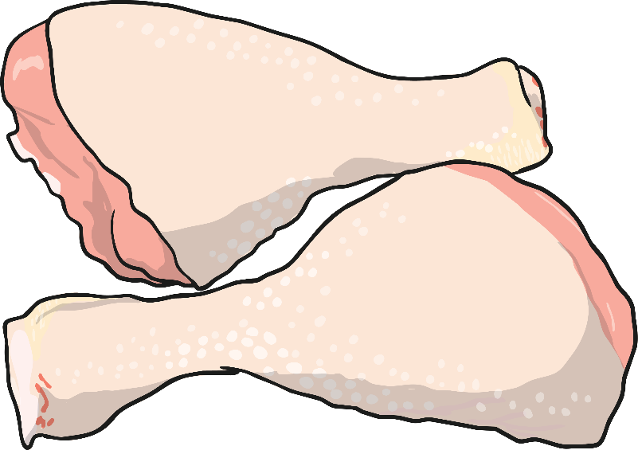
le poulet

Slide 8
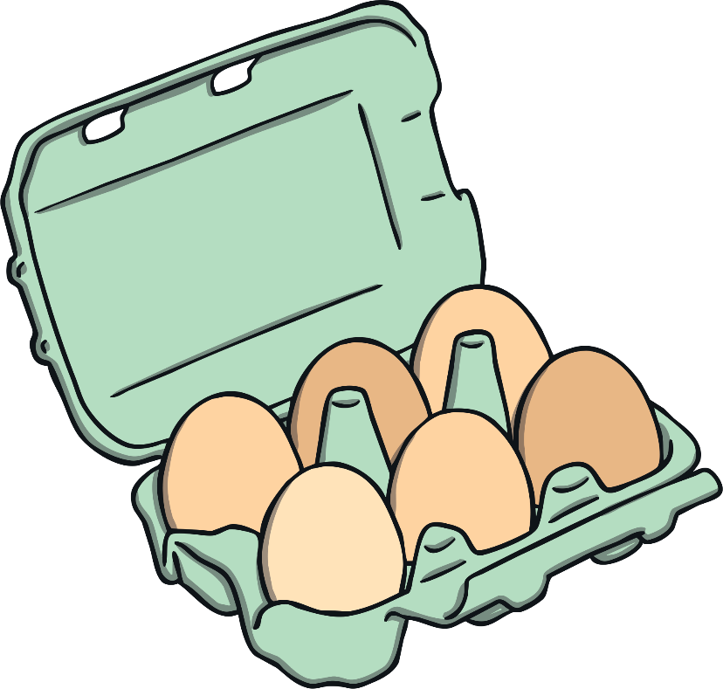
les œufs

Slide 9
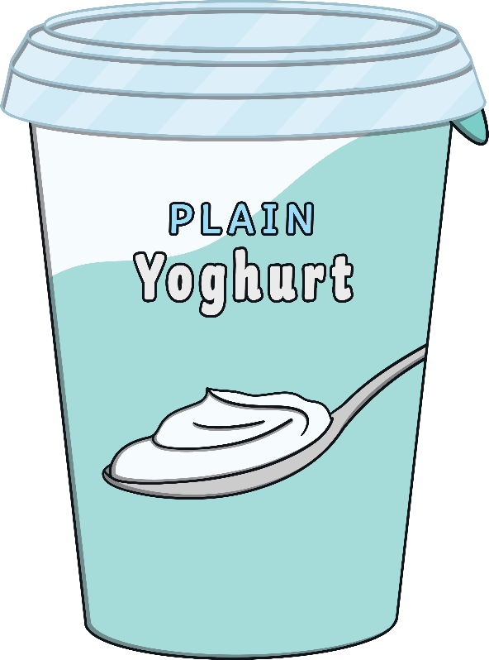
le yaourt

Slide 10
le chocolat

Slide 11
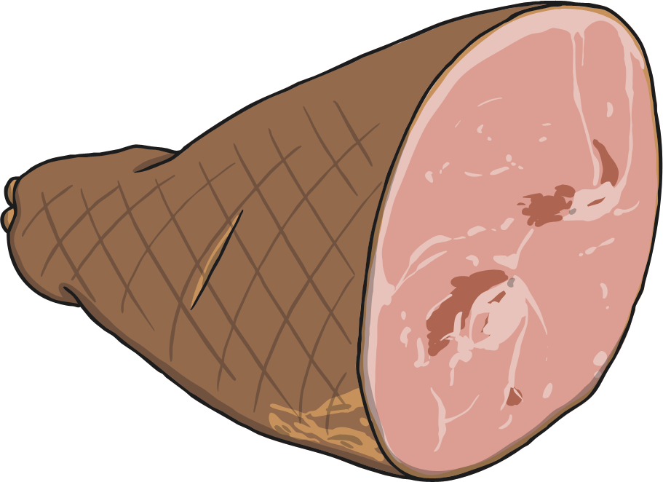
le jambon

Slide 12
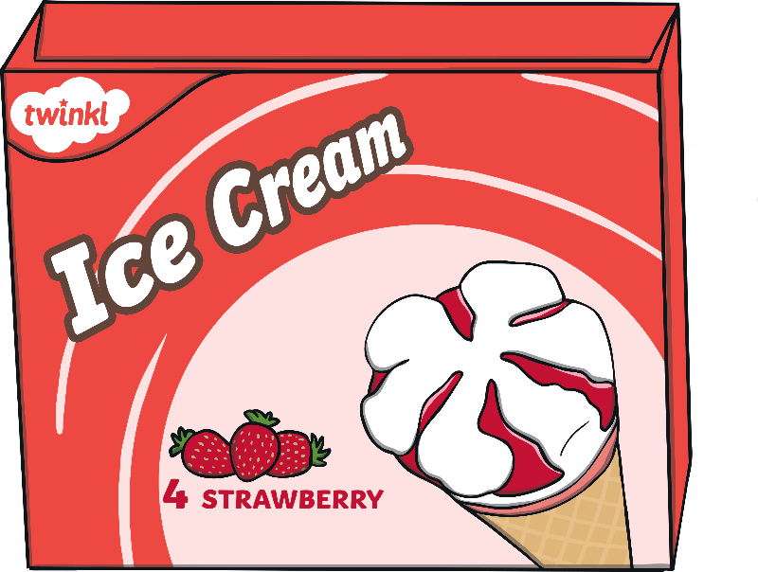
la glace

Slide 13
le fromage

Slide 14
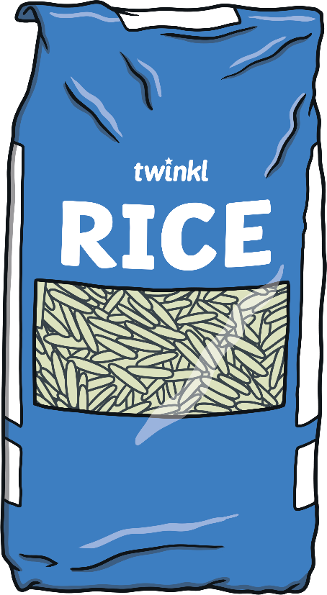
le riz

Slide 15
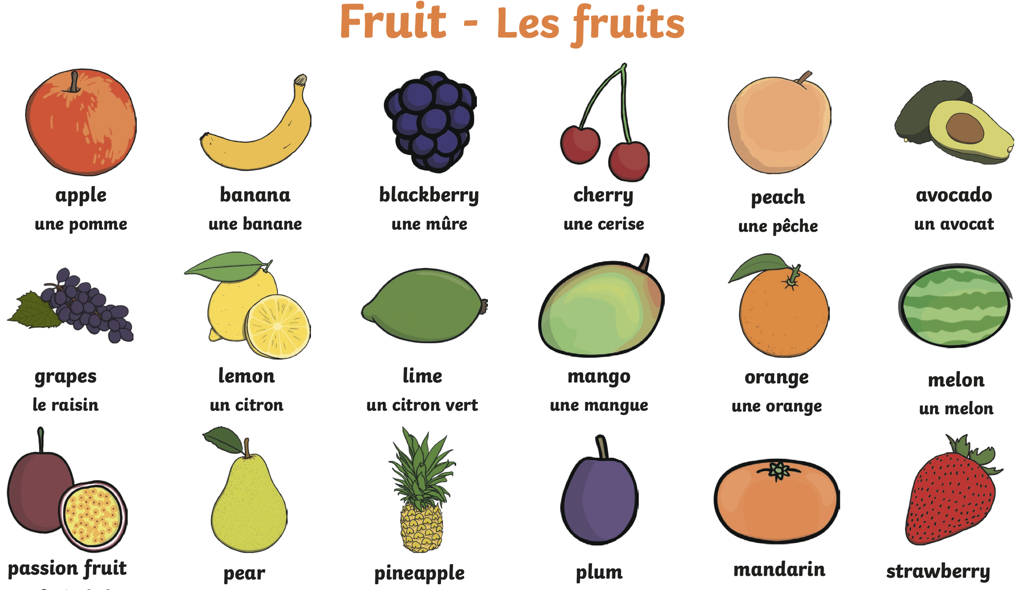

Slide 16
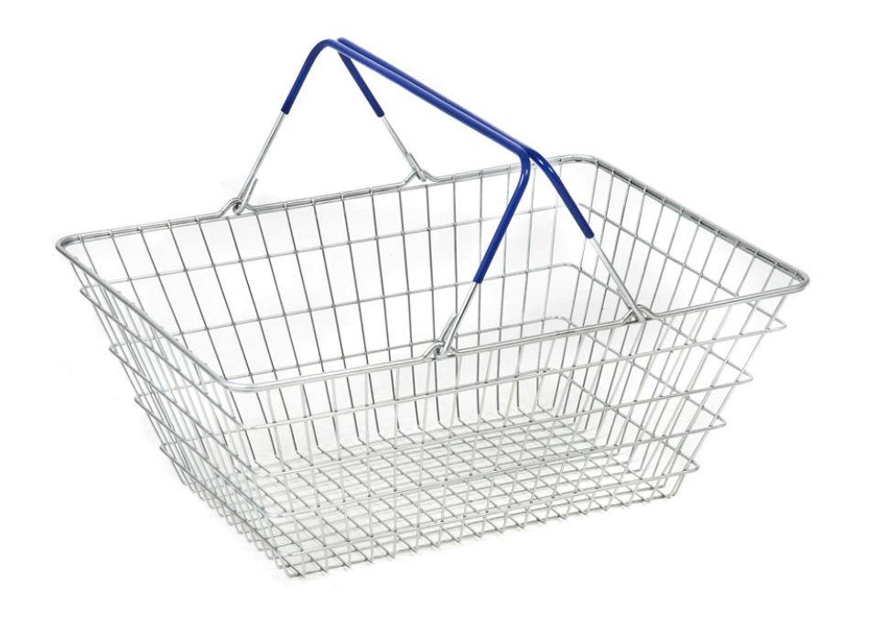
Task :
You need to cut out the basket / or draw a basket and glue it in your books.
In your shopping basket, you need at least 1 food you like and don’t like.
Can you tell me why?
Challenge:
Can you find research the name of a food we have not discussed and add it to your basket.

