Slide 1
LT I can write effective sentences for a story with action verbs.

Slide 2
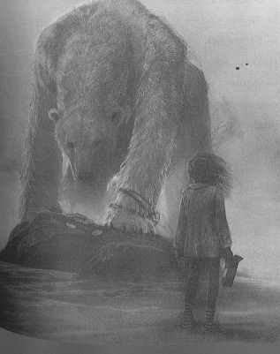
Watch some of the video clip https://www.youtube.com/watch?v=nFsdaYuIJCU
Label the body parts of a polar bear. Write phrases about how they would move when meeting April.

Slide 3
Task
Write a couple of paragraphs about what you imagine might happen when April meets the polar bear. Think carefully about which verbs you will include to describe their actions.

